Slide 1
assignment
. I installed linux ubuntu on my machine and that is what I work with this entire course work
Process
Preparation:
Download the Ubuntu ISO image for your desired version from https://ubuntu.com/download/desktop.
Ensure you have a USB drive with enough space (at least 4GB).
Create a bootable USB drive:
Use a tool like dd (be cautious, using dd incorrectly can erase data) or a graphical tool like Startup Disk Creator (if available).
Identify your USB drive using lsblk.
Unmount the drive (if mounted) with sudo umount /dev/sdX (replace sdX with your drive letter).
Write the ISO to the USB drive with sudo dd bs=4M if=ubuntu.iso of=/dev/sdX status=progress,noerror (replace ubuntu.iso with your filename and /dev/sdX with your drive letter). Important: Double-check the drive letter to avoid data loss.
Boot from the USB drive:
Restart your computer.
Enter the boot menu (usually by pressing F10, F12, or Esc during startup).
Select the option to boot from your USB drive.
Install Ubuntu:
Follow the on-screen instructions during the Ubuntu live boot.
Choose "Install Ubuntu" when prompted.
Select your preferred installation options (language, keyboard layout, partitioning, etc.).
The installer will guide you through the remaining steps, including creating a user account and setting a password.
Complete the installation:
Once the installation is complete, restart your computer.
Remove the USB drive.
You should now boot directly into your newly installed Ubuntu system.

Slide 2
2.
My text editter I chose to install was vs code
Method 2: Using the Command Line
Open a terminal window (Ctrl+Alt+T).
Update the package lists:
sudo apt update
Install VS Code:
sudo apt install code
Enter your password when prompted for authentication.
The installation will progress, and once complete, VS Code will be available to launch by typing code in the terminal.

Slide 3
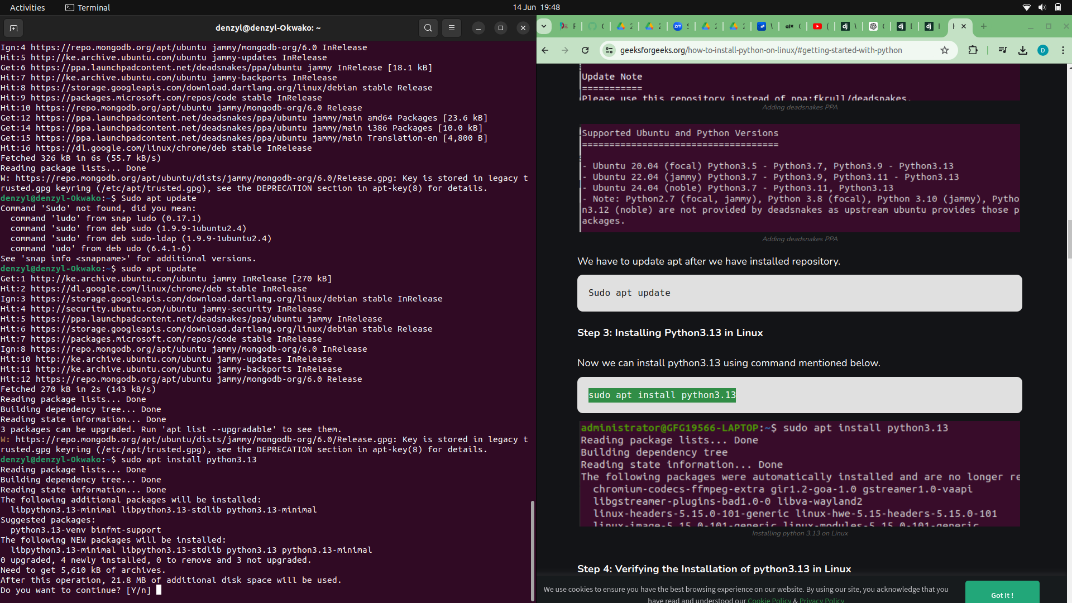

Slide 4
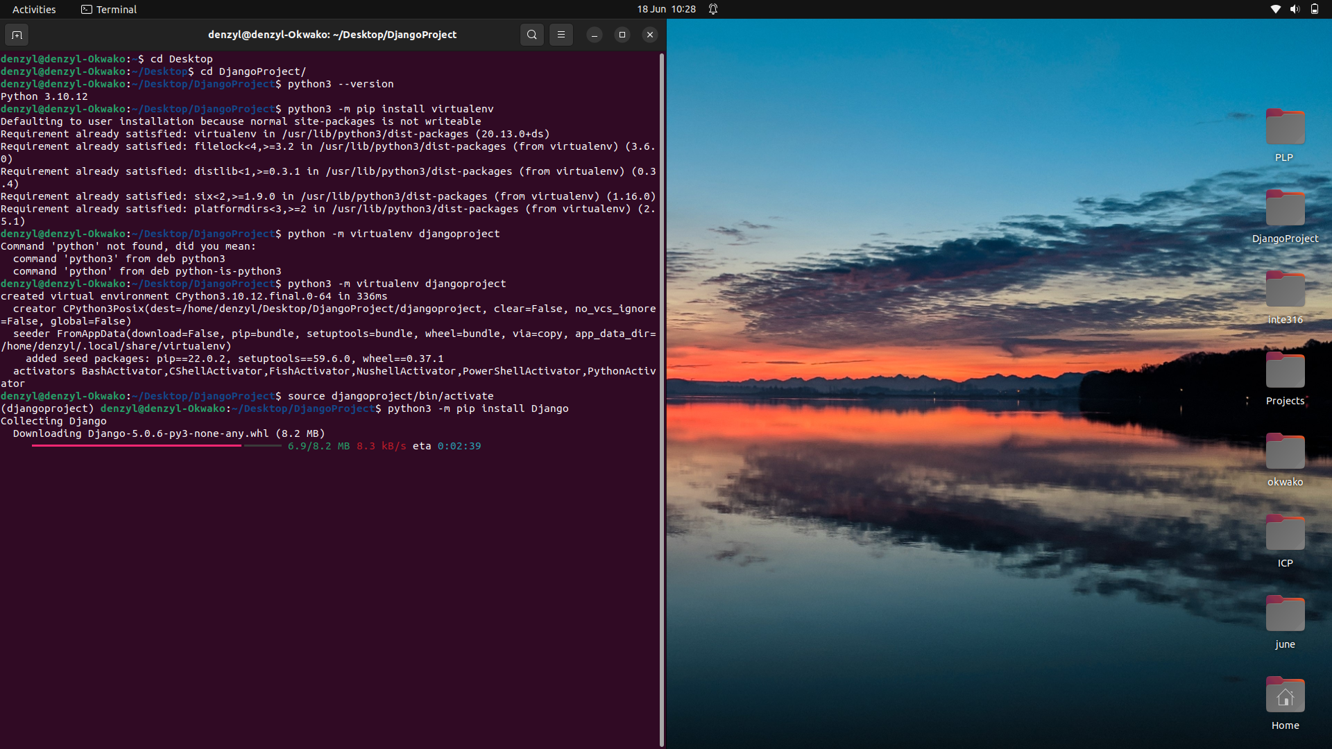

Slide 5
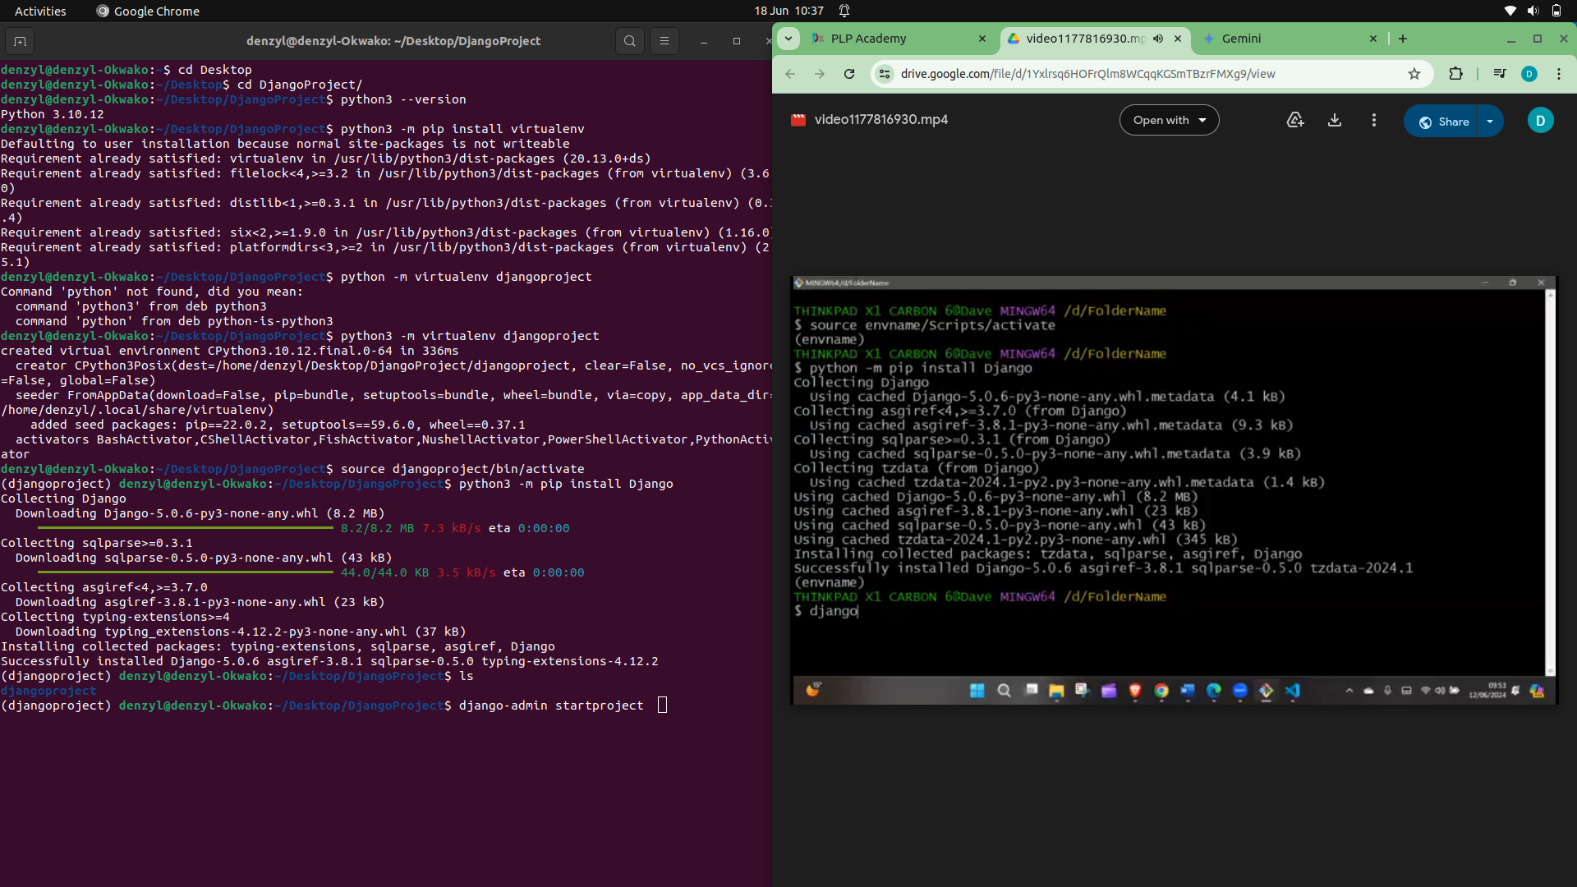

Slide 6
